Slide 1


NAAC Accredited With Grade-"A"
DEPARTMENT OF COMPUTER ENGINEERING
A Project On
STARE-A Notice Board
A Project by:-
BASUTKAR SOHAN (COSB75)
SALUNKE HITESH (COSB77)
PANDE TEJAS (COSB58)
PANHALKAR MUFID (COSB60)
MUNDE MAHADEV (COSB54)
PAWAR ADITYA (COSB64)
Guided by:-
Prof . S. B. Ghawate

Slide 2





STARE
A Notice Board

Slide 3
Table Of Content
Introduction
Problem Statement
Objectives
Features
Methodology
Technology Used
Modules
Conclusion

Slide 4


Introduction
What is Virtual Notice Board?
Virtual notice boards are digital platforms that allow for the display of information, messages and announcements in a dynamic and interactive manner.
They serve as a modern-day alternative to traditional bulletin boards that are often limited by physical space and accessibility.
By using virtual notice boards, users can easily view notices from anywhere , at any time.
These can be accessed through a computer, tablet or smartphone, making them highly convenient and accessible.
Web Application
Admin and student need to login / signup.
Admin will manage notice dashboard, student, and student corner.
Student see notice, manage their profile & post on student corner.

Slide 5
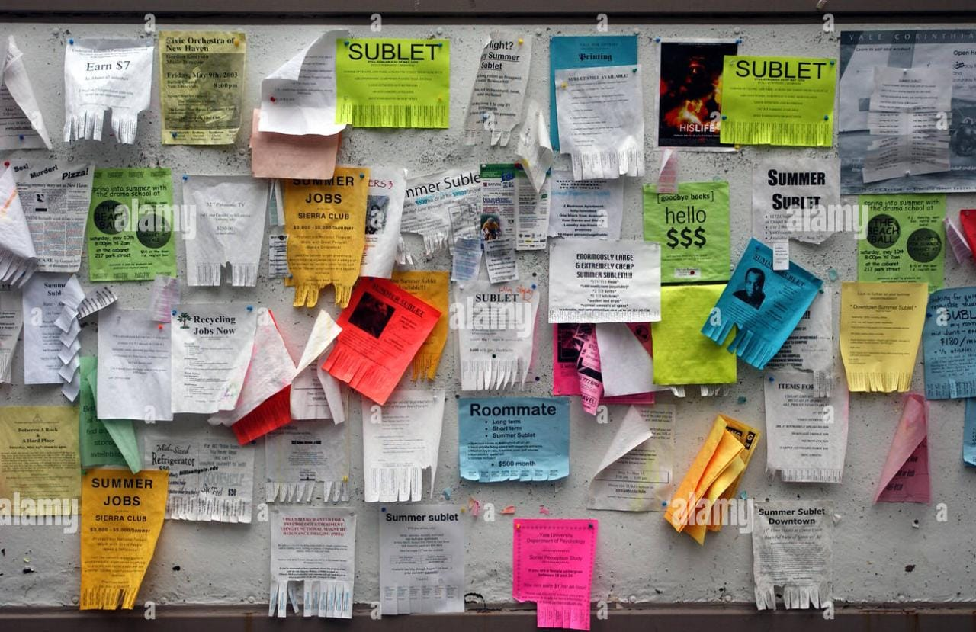
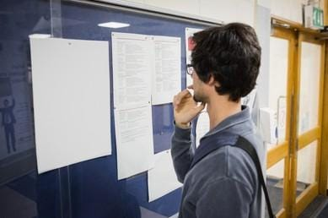
Problem Statement
What is problem with traditional Notice Board[Existing System]?
Insufficient space leading to overlapping posts.
It is hard to know the latest posts.
You cannot know how many people viewed your post.
You don’t have direct access to the people who post.
It’s exhausting to keep checking the notice board for new posts.
It’s not easily accessible, among other limitations that surround the
normal notice board.

Slide 6

Objectives
What is Stare-A Notice Board[Proposed System]?
Provide a centralized platform to post notices and updates, which can be easily accessed by their students.
The website aims to improve communication between institutions and students, with a user-friendly interface that allows admins to write important notices.
The ultimate goal of the project is to enhance student engagement, satisfaction, and academic performance by providing timely and relevant information.

Slide 7



features
User Registration and Authentication
Customizable Notifications
User-Friendly Interface
Users will be able to register and create an account to receive notifications on various topics.
The authentication process will ensure that the user's information is secure and protected.
Users will be able to select their preferences for notification frequency and categories.
Ensuring that user only receive the information that is relevant to them.
It will have a simple and intuitive interface that is easy to navigate and use.
It is accessible to a broad range of users.

Slide 8





Methodology
Requirement
Gathering
Analysis
design
coding
testing
Purpose
Features
Functionalities
Constraints
Comparing information
Check quality
Identify problems
Layout
User Interface[UI]
Architecture
Technologies
Functionality
Tools
Services
Database Structure
Functional testing
Performance testing
Security testing
User acceptance testing

Slide 9





Technology used
frontend
backend
ide
server
database
HTML, CSS, JAVASCRIPT
PHP
Visual Studio Code
Localhost
Mysql

Slide 10
Modules
Admin Module
User Module
Home
Add Notices
View Notices
Art Villa
Register
Edit Profile
Login
Home
Student Registration
Notices
Profile
Register
Login

Slide 11
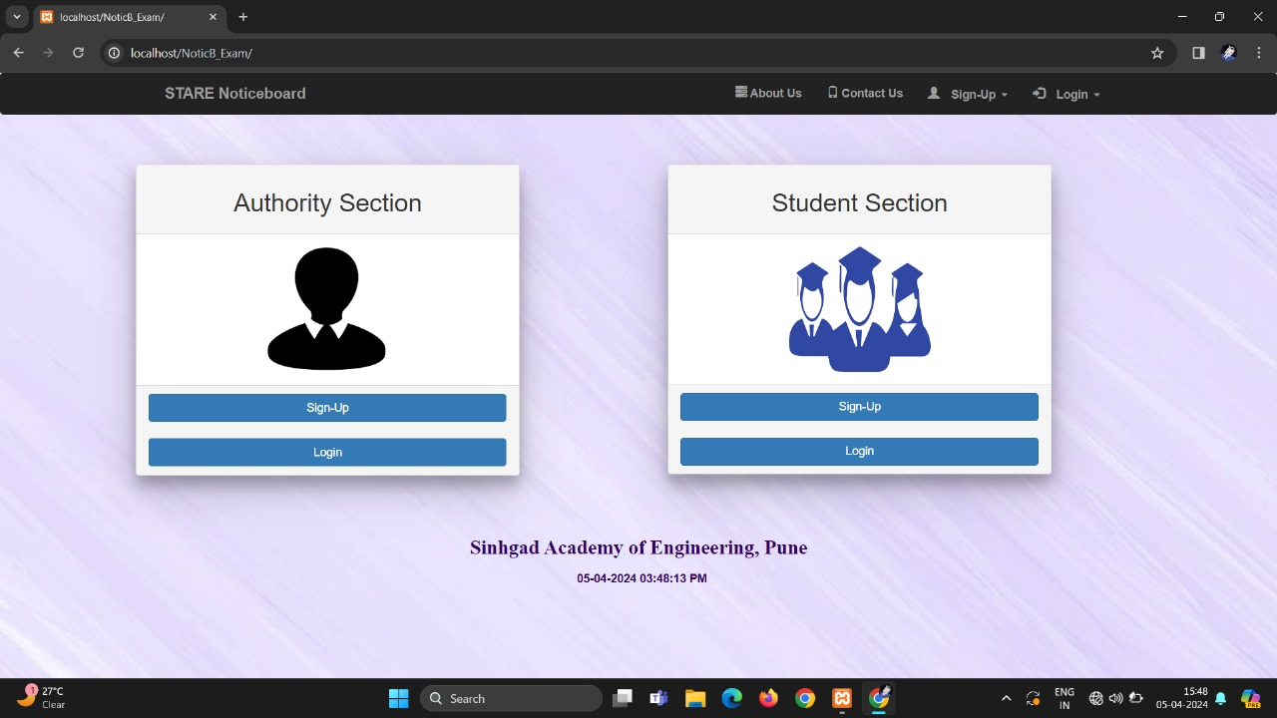
Authentication [user and admin]
Here the user or admin will have the
enter the correct credential to login into
their account
And if the new user comes firstly he/she
will have to register the website first.

Slide 12
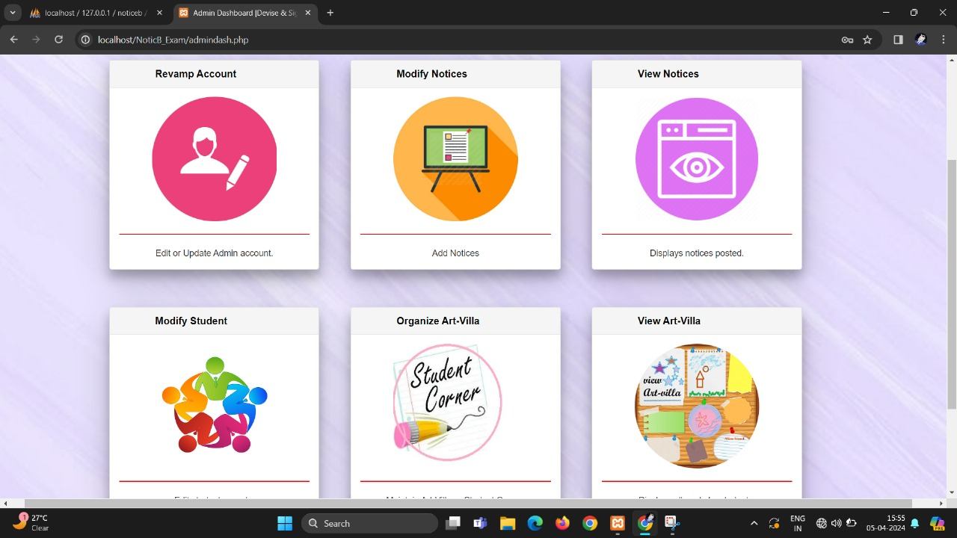
Home page [user and admin]
After Successfully login into the
website the your will be redirected to
the home page.
Home page contains notices, Artvilla, Edit Profile

Slide 13
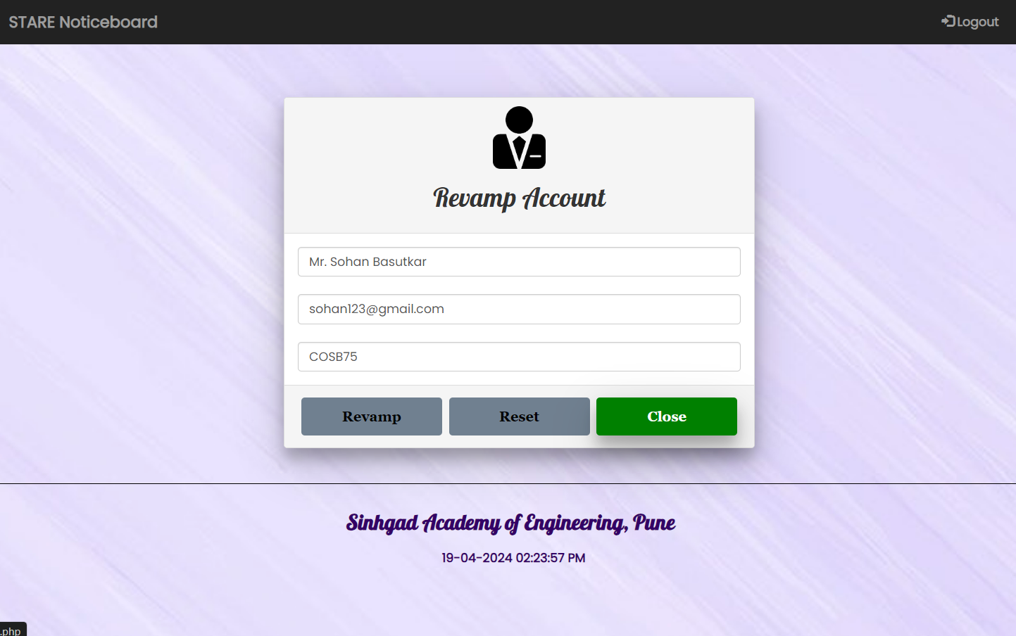
Profile [user and admin]
User and Admin can edit there profile too.
After edit profile user has to exist with that identity.
Profile edit option enables to change each
and every thing in that form

Slide 14
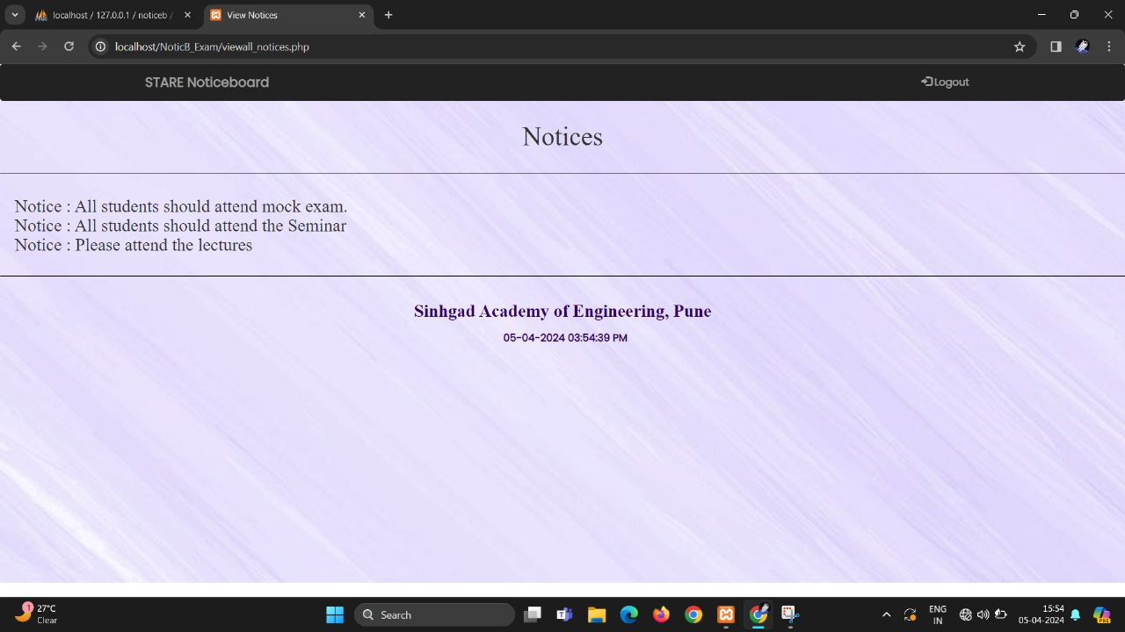
Notices [user and admin]
In this section user can received latest notices from admin
In this section admin can see which notice is post by others admin or notices which upload by himself.

Slide 15
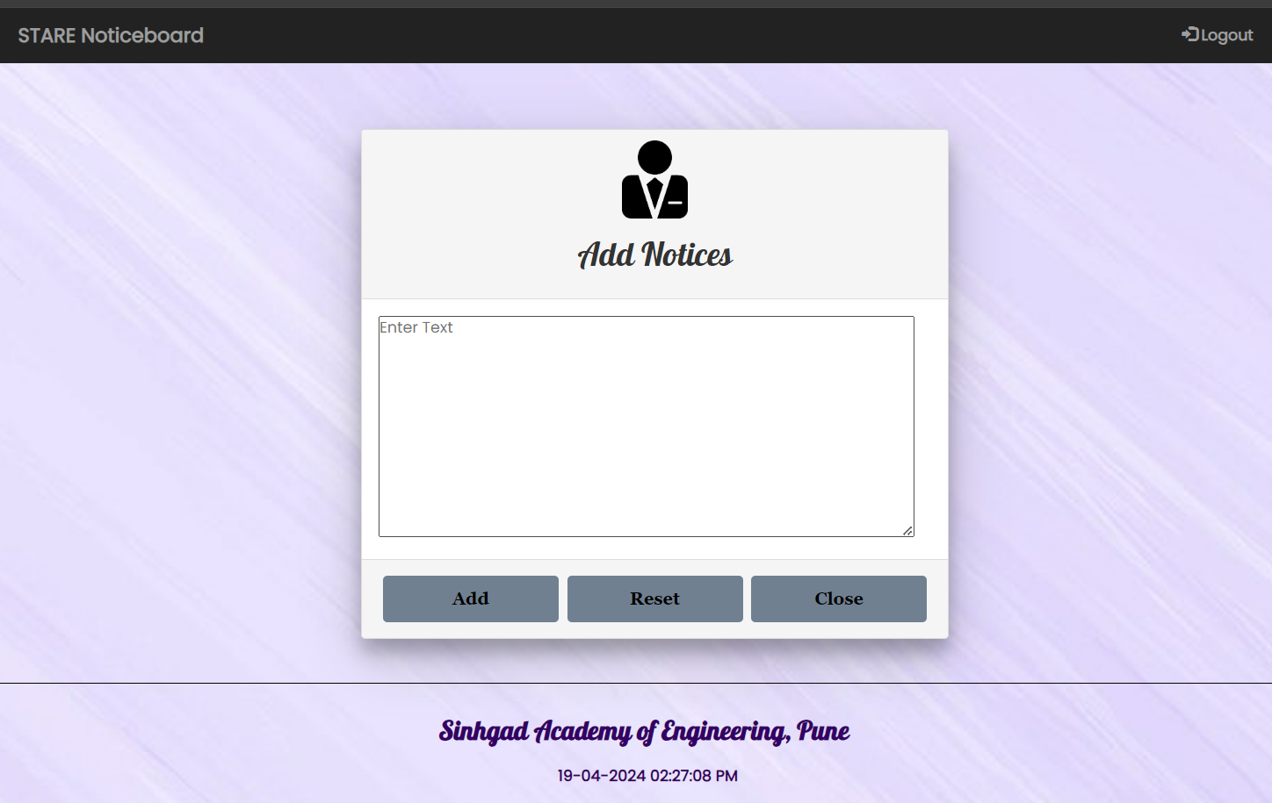
Create notices [admin]
In this section admin write notice for users.
In this section admin have to write notice, its description, send to which user etc.

Slide 16
Conclusion
In conclusion, the development of a virtual notice board for our educational institution is a significant step towards improving communication and engagement between students, faculty, and staff.
We have developed a platform that is efficient, user-friendly, and effective, providing a centralized location for sharing information and updates.
STARE-A virtual notice board will improve communication and engagement within our educational institution.

Slide 17
A notice board is not just a means of communication, but also a reflection of the values and culture of an organization or community.
“
”

Slide 18
THANK YOU

